Slide 1
DAY : 01

Slide 2
ES6 − Syntax
Syntax defines the set of rules for writing programs. Every language specification defines its own syntax.
A JavaScript program can be composed of:
Variables: Represents a named memory block that can store values for the program.
Operators: Symbols that define how the operands will be processed
Keywords: Words that have a special meaning in the context of a language.

Slide 3
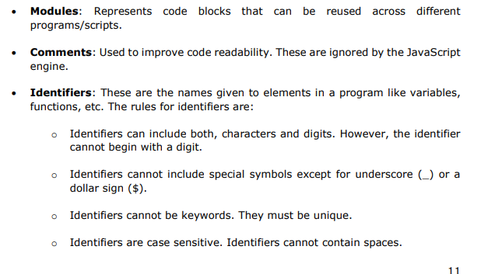

Slide 4
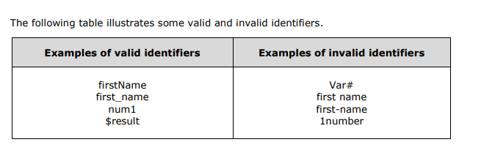
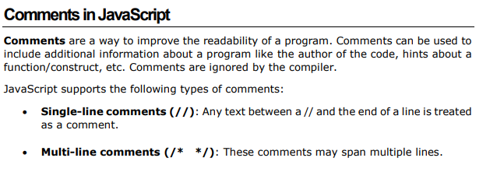

Slide 5
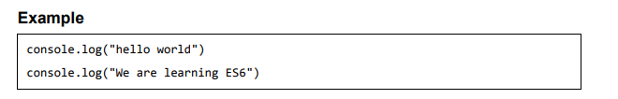
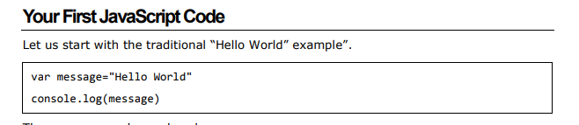

Slide 6


Slide 7
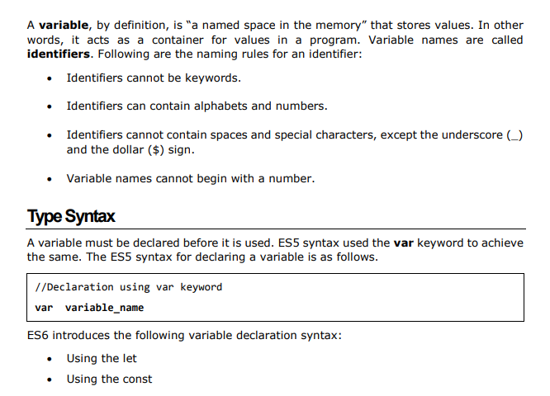

Slide 8
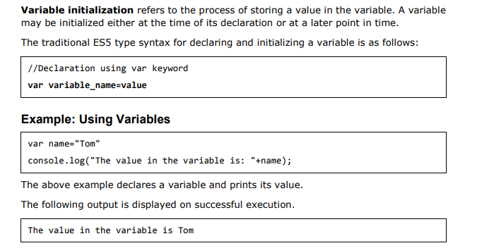

Slide 9
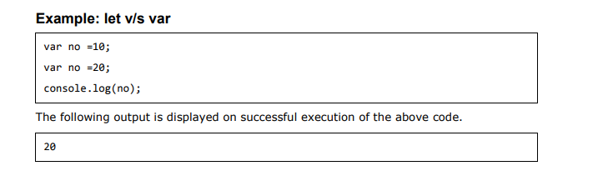
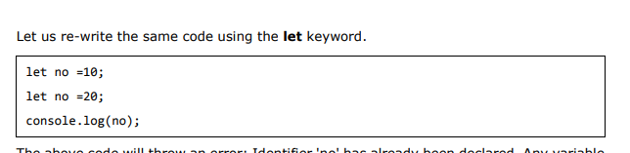

Slide 10
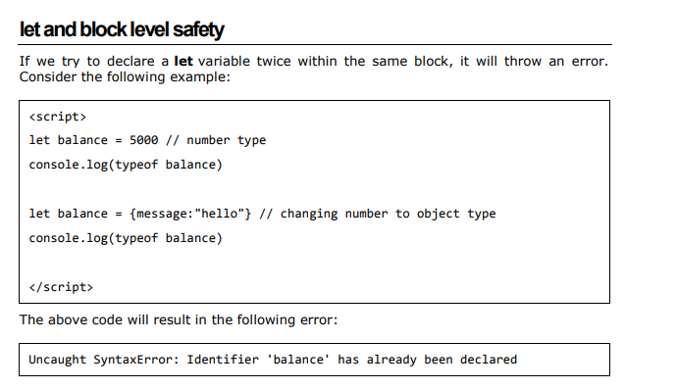

Slide 11
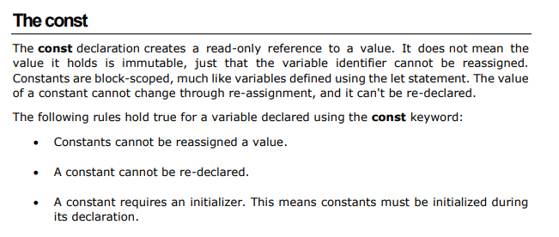
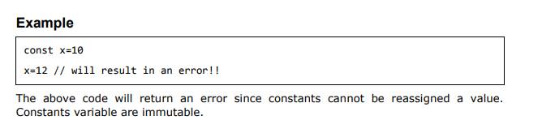

Slide 12
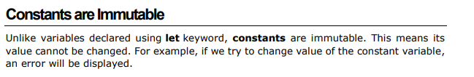
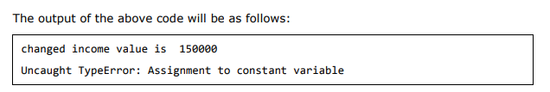
<script>
let income = 100000
const INTEREST_RATE = 0.08
income += 50000 // mutable
console.log("changed income value is ",income)
INTEREST_RATE += 0.01
console.log("changed rate is ",INTEREST_RATE) //Error: not mutable
</script>

Slide 13
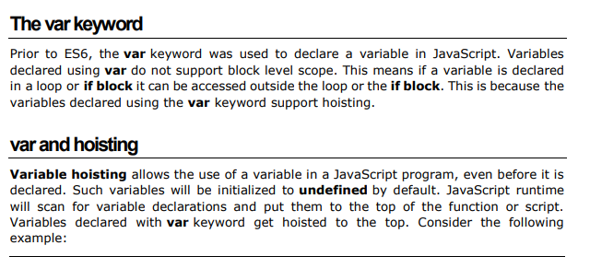

Slide 14
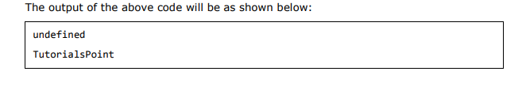
<script>
// variable company is hoisted to top , var company = undefined
console.log(company); // using variable before declaring
var company = "TutorialsPoint"; // declare and initialized here
console.log(company);
</script>

Slide 15
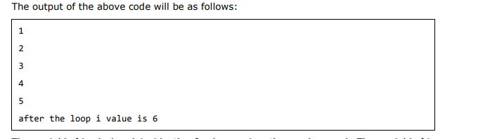
<script> //hoisted to top ; var i = undefined for (var i=1;i<=5;i++){ console.log(i); } console.log("after the loop i value is "+i); </script>

Slide 16
DAY : 02

Slide 17


Slide 18
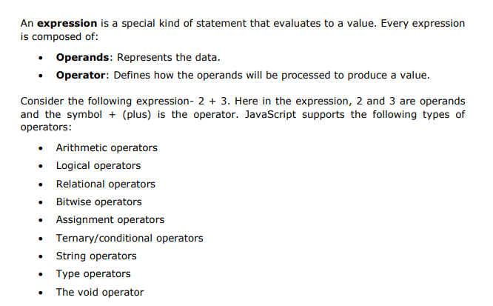

Slide 19
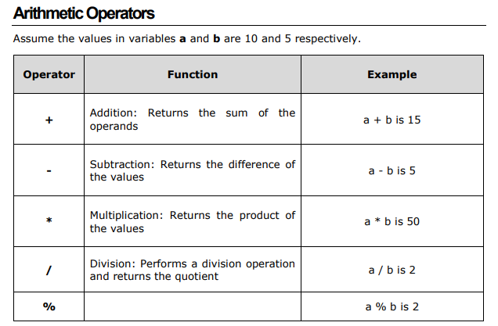

Slide 20
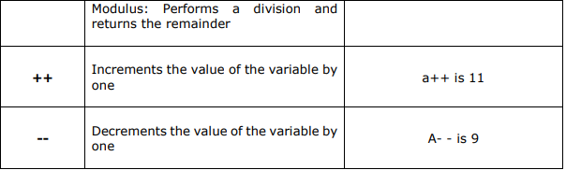

Slide 21
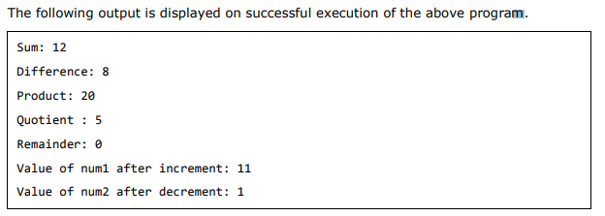
var num1=10 var num2=2 var res=0 res= num1+num2 console.log("Sum: "+ res); res=num1-num2; console.log("Difference: "+res) res=num1*num2 console.log("Product: "+res) res=num1/num2 console.log("Quotient: "+res) res=num1%num2 console.log("Remainder: "+res) num1++ console.log("Value of num1 after increment "+num1) num2– console.log("Value of num2 after decrement "+num2)

Slide 22
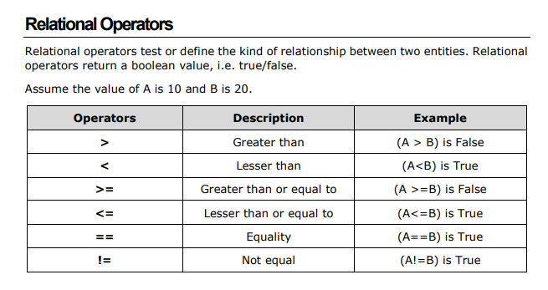

Slide 23
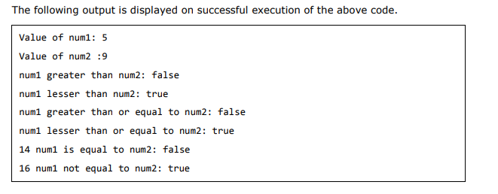
Example
var num1 = 5;
var num2 = 9;
console.log("Value of num1: " + num1);
console.log("Value of num2 :" + num2);
var res = num1 > num2;
console.log("num1 greater than num2: " + res);
res = num1 < num2;
console.log("num1 lesser than num2: " + res);
res = num1 >= num2;
console.log("num1 greater than or equal to num2: " + res);
res = num1 <= num2;
console.log("num1 lesser than or equal to num2: " + res);
res = num1 == num2;
console.log("num1 is equal to num2: " + res);
res = num1 != num2;
console.log("num1 not equal to num2: " + res);

Slide 24
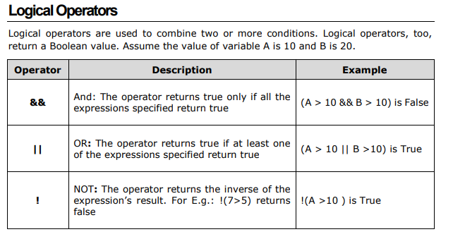

Slide 25
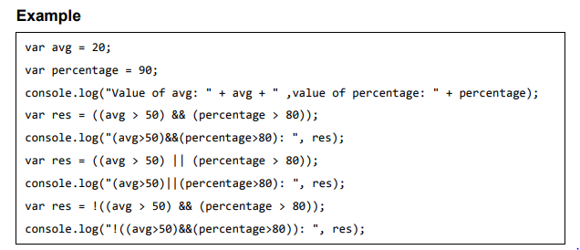
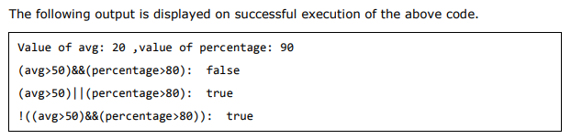

Slide 26
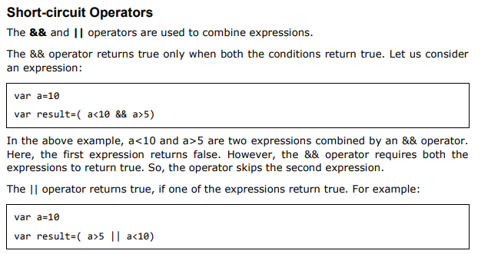

Slide 27
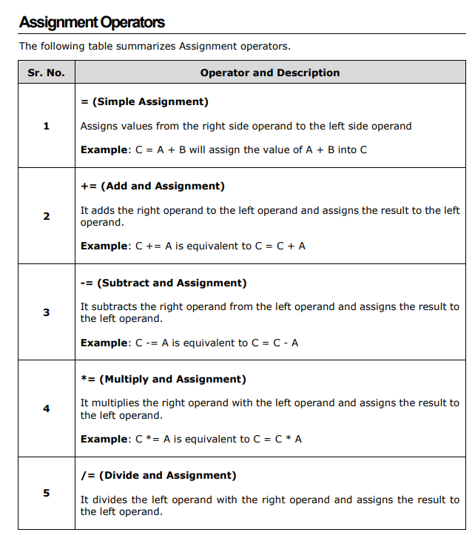

Slide 28
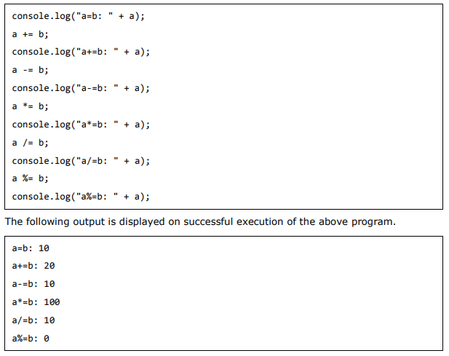

Slide 29
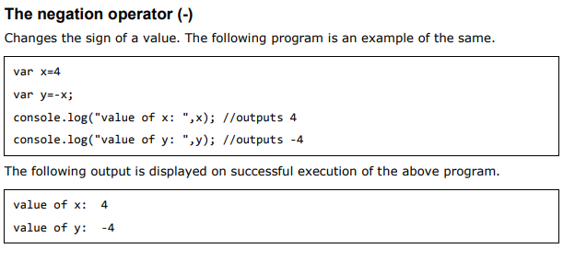

Slide 30
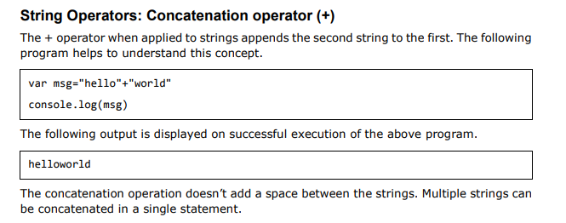

Slide 31
DAY : 04

Slide 32
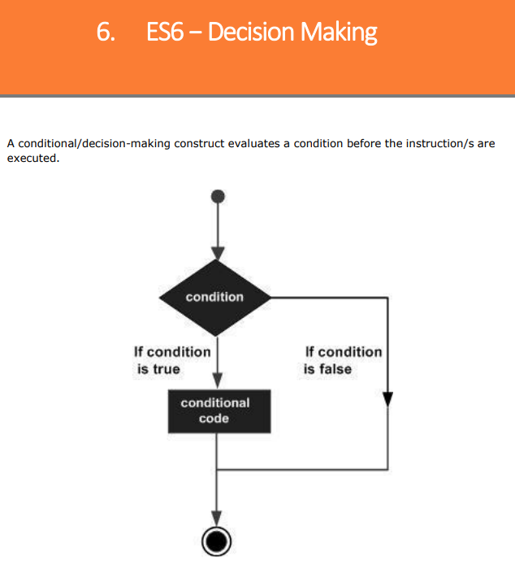

Slide 33
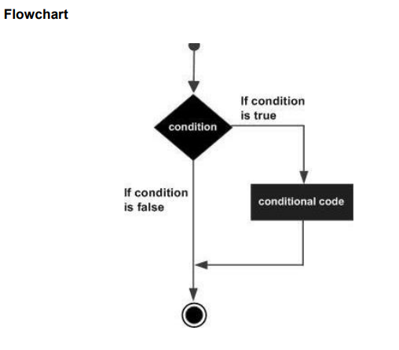

Slide 34
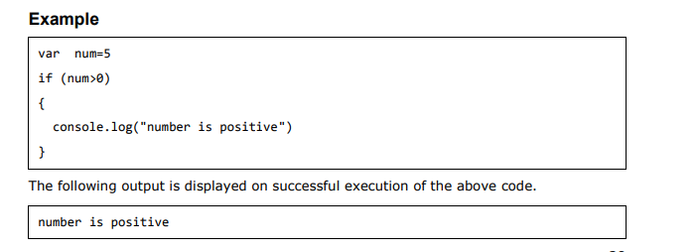

Slide 35
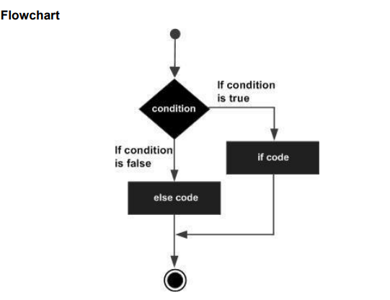

Slide 36
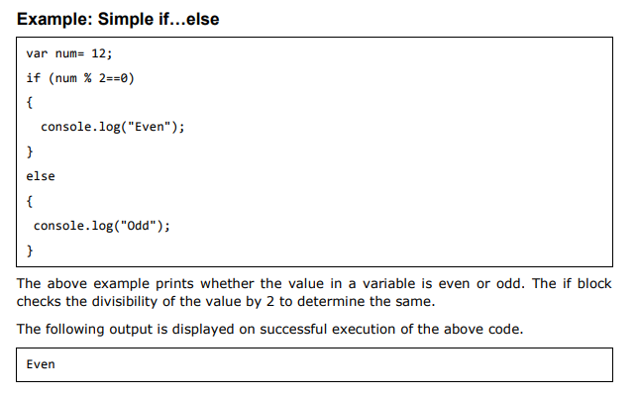

Slide 37
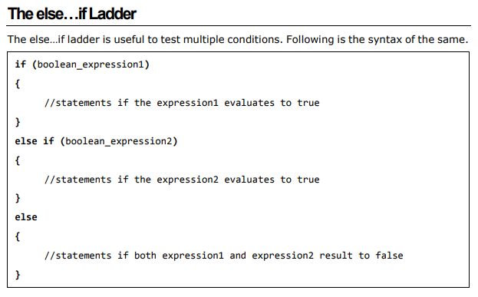

Slide 38
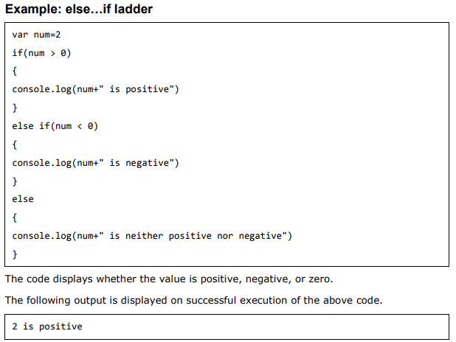

Slide 39
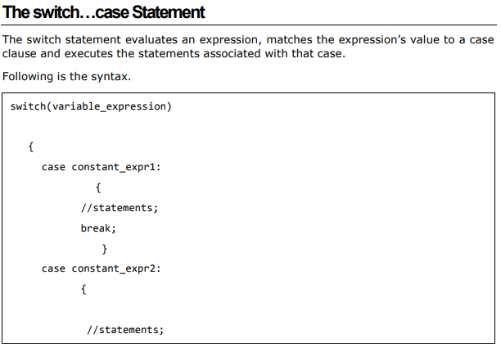

Slide 40
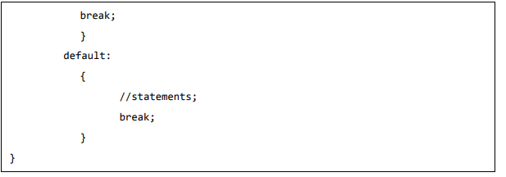

Slide 41
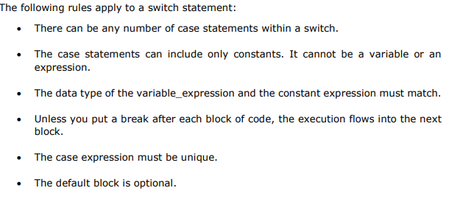

Slide 42
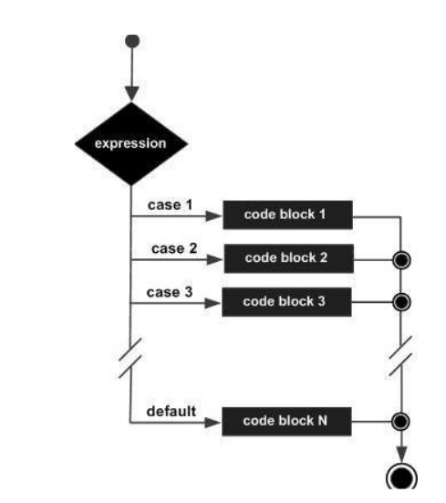

Slide 43
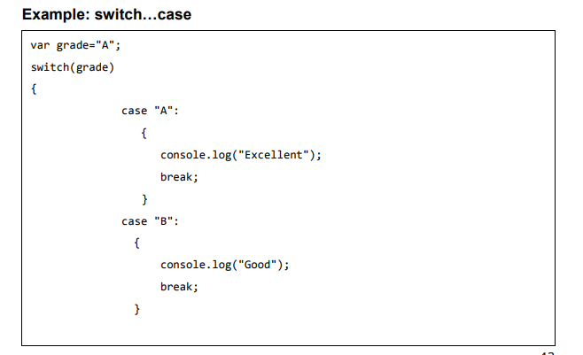
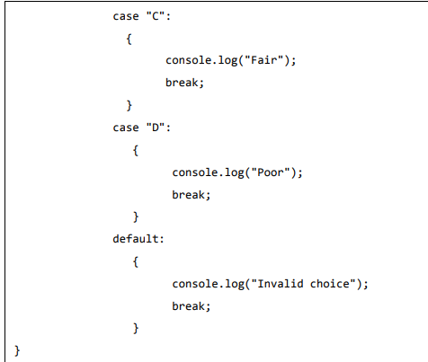
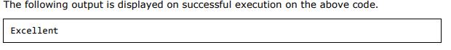

Slide 44
DAY : 06

Slide 45
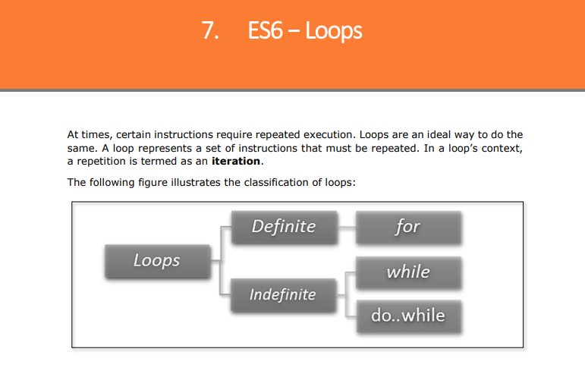

Slide 46
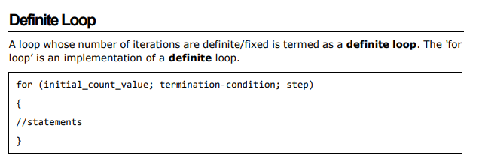

Slide 47
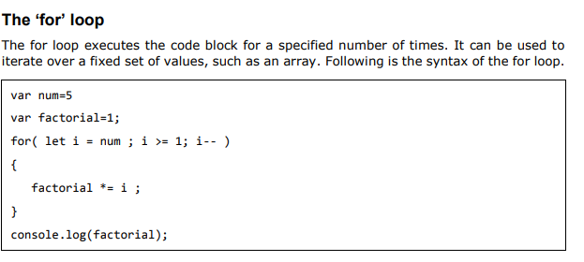

Slide 48
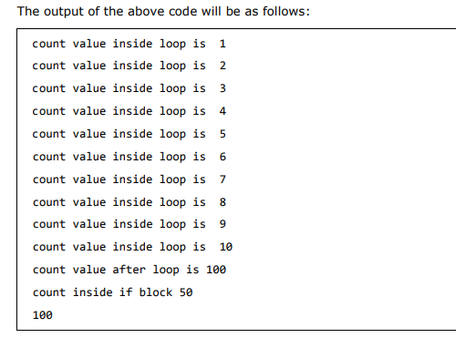
<script>
let count=100
for (let count =1;count<=10;count++){
//inside for loop brackets ,count value starts from 1
console.log("count value inside loop is ",count);
}
//outside for loop brackets ,count value is 100
console.log("count value after loop is",count);
if(count==100
let count=50;
console.log("count inside if block",count); }
console.log(count);
</script>

Slide 49
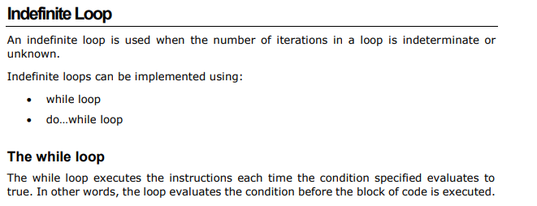

Slide 50


Slide 51


Slide 52


Slide 53


Slide 54



Slide 55


Slide 56


Slide 57
DAY : 08

Slide 58


Slide 59


Slide 60


Slide 61



Slide 62


Slide 63


Slide 64


Slide 65


Slide 66




Slide 67



Slide 68


Slide 69



Slide 70



Slide 71




Slide 72




Slide 73



Slide 74


Slide 75



Slide 76



Slide 77



Slide 78


Slide 79



Slide 80



Slide 81


Slide 82




Slide 83



Slide 84



Slide 85


Slide 86




Slide 87


Slide 88



Slide 89


Slide 90


Slide 91



Slide 92
DAY : 10

Slide 93


Slide 94


Slide 95



Slide 96


Slide 97


Slide 98


Slide 99


Slide 100


Slide 101


Slide 102


Slide 103


Slide 104


Slide 105


Slide 106



Slide 107


Slide 108


Slide 109


Slide 110


Slide 111


Slide 112


Slide 113


Slide 114


Slide 115


Slide 116


Slide 117


Slide 118


Slide 119



Slide 120
DAY : 13

Slide 121


Slide 122



Slide 123


Slide 124



Slide 125



Slide 126



Slide 127



Slide 128



Slide 129



Slide 130



Slide 131



Slide 132



Slide 133



Slide 134



Slide 135



Slide 136


Slide 137


Slide 138


Slide 139



Slide 140


Slide 141



Slide 142


Slide 143


Slide 144



Slide 145


Slide 146



Slide 147


Slide 148


Slide 149


Slide 150


Slide 151


Slide 152
DAY : 14

Slide 153


Slide 154


Slide 155


Slide 156


Slide 157




Slide 158


Slide 159



Slide 160




Slide 161



Slide 162


Slide 163



Slide 164


Slide 165


Slide 166



Slide 167


Slide 168


Slide 169


Slide 170


Slide 171


Slide 172


Slide 173


Slide 174
DAY : 16

Slide 175



Slide 176


Slide 177



Slide 178


Slide 179


Slide 180



Slide 181


Slide 182



Slide 183


Slide 184


Slide 185
DAY : 18

Slide 186


Slide 187



Slide 188



Slide 189


Slide 190



Slide 191


Slide 192


Slide 193


Slide 194


Slide 195


Slide 196


Slide 197



Slide 198


Slide 199



Slide 200


Slide 201


Slide 202


Slide 203



Slide 204



Slide 205



Slide 206
DAY : 20

Slide 207



Slide 208


Slide 209


Slide 210


Slide 211


Slide 212


Slide 213


Slide 214


Slide 215


Slide 216


Slide 217



Slide 218


Slide 219


Slide 220
DAY : 21

Slide 221



Slide 222



Slide 223


Slide 224


Slide 225



Slide 226


Slide 227


Slide 228


Slide 229


Slide 230


Slide 231


Slide 232


Slide 233


Slide 234


Slide 235


Slide 236


Slide 237



Slide 238


Slide 239


Slide 240



Slide 241
DAY : 22

Slide 242


Slide 243


Slide 244


Slide 245


Slide 246
DAY : 24

Slide 247


Slide 248



Slide 249




Slide 250



Slide 251


Slide 252



Slide 253


Slide 254




Slide 255


Slide 256



Slide 257


Slide 258


Slide 259


Slide 260




Slide 261
DAY : 26

Slide 262
Callback function
Callback function:-
A callback function is a function passed into another function as an argument, which is then invoked inside the outer function to complete some kind of routine or action. The benefit of using a callback function is that you can wait for the result of a previous function call and then execute another function call.

Slide 263


For example:-

Slide 264
Template literals(Template string)
Template Literals:-
Template literals is an JS ES-6 (ECMASCRIPT-6) feature which is used to interpolate(concatenate) variables and expressions into strings. Template literals allow us to use variables within string without using plus (+) operator

Slide 265


For example:-

Slide 266
Local Storage in JS
Local Storage:-
The local storage is a Web storage object allows you to save data in a browser, in key/value pairs. The cool feature of this storage is that the data in this will remain save until the user delete it yourself. The data is not deleted when the browser is closed as well. To interact data in local storage, we have the following basic methods
setItem()
getItem()
removeItem
clear()

Slide 267
setItem():- Add key and value to local storage

Slide 268



Slide 269

getItem():- This is used to get your stored item from local storage

Slide 270

removeItem():- This is used to remove an item by key from local storage
clear():- clear() method is used to delete all items from local storage

Slide 271
DAY 27

Slide 272


Slide 273



Slide 274


Slide 276


Slide 277


Slide 278

Fetch API
Fetch API:-
fetch() method is used to handle asynchronous calls. For example request data from a server, API Integration etc. It returns a promise

Slide 279

async / await
DAY 30

Slide 280
THE END

